Slide 1
Performance Analysis of Parallel Programs

Slide 2
Learning Objectives
Predict performance of parallel programs
Understand barriers to higher performance

Slide 3
Outline
General speedup formula
Amdahl’s Law
Gustafson-Barsis’ Law
Karp-Flatt metric
Isoefficiency metric

Slide 4
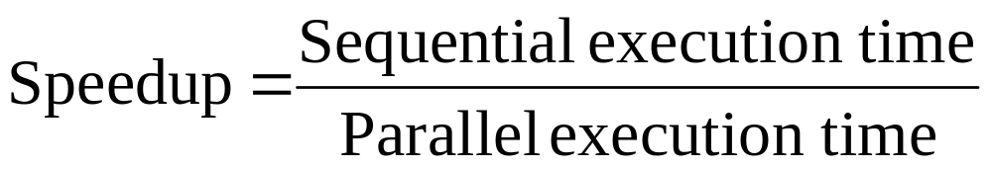
Speedup Formula

Slide 5
Execution Time Components
Inherently sequential computations: σ(n)
Potentially parallel computations: ϕ(n)
Communication operations: κ(n,p)

Slide 6
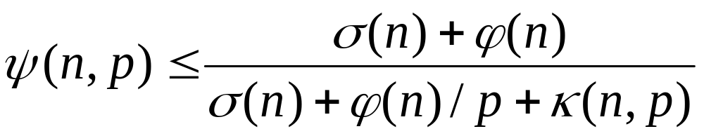
Speedup Expression

Slide 7
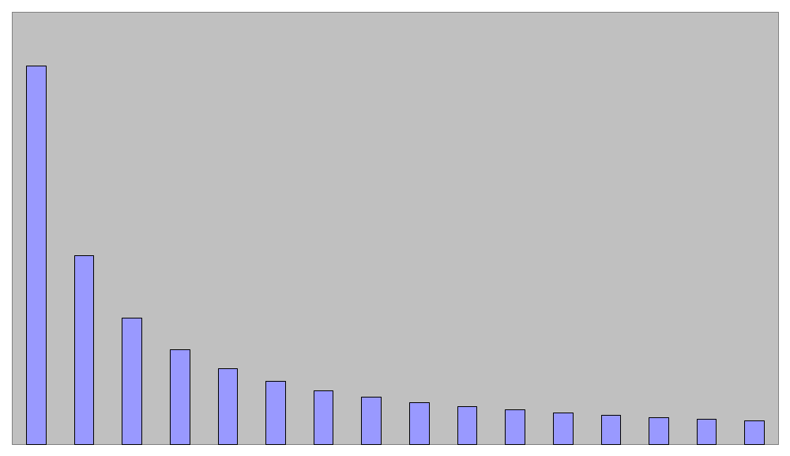
ϕ(n)/p

Slide 8
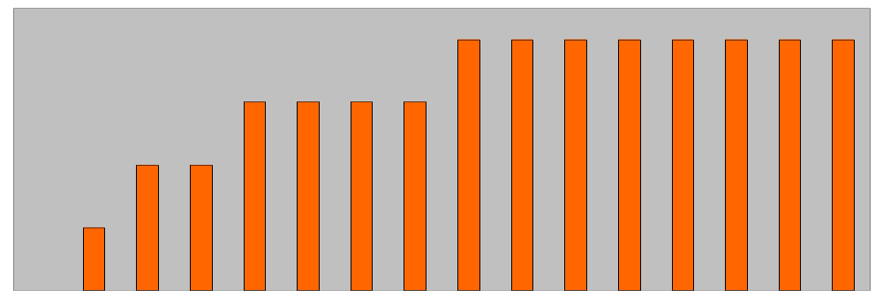
κ(n,p)

Slide 9
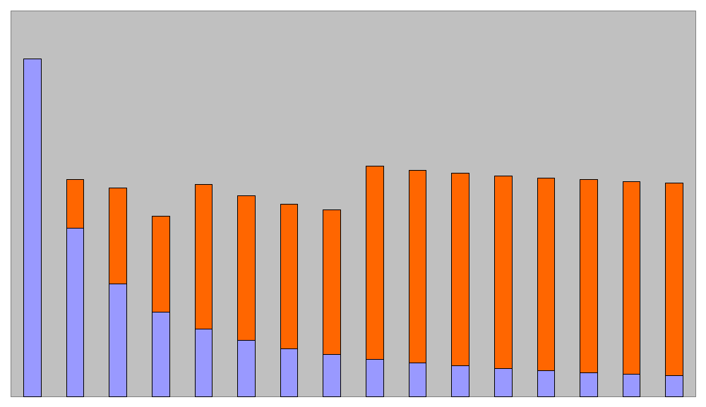
ϕ(n)/p + κ(n,p)

Slide 10
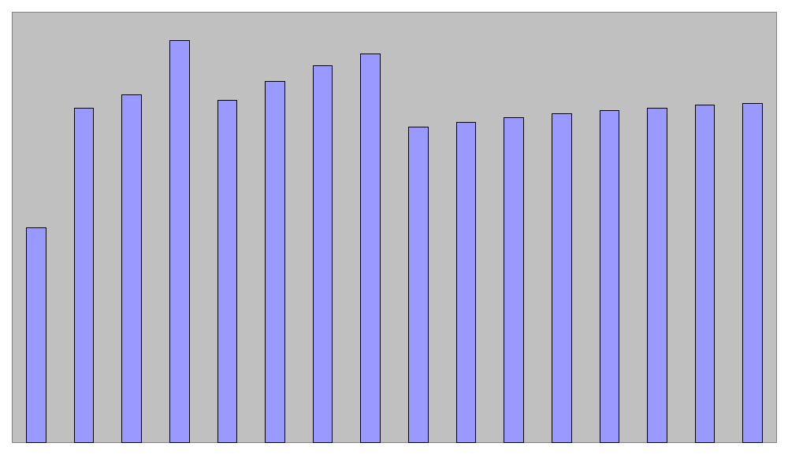
Speedup Plot
“elbowing out”

Slide 11
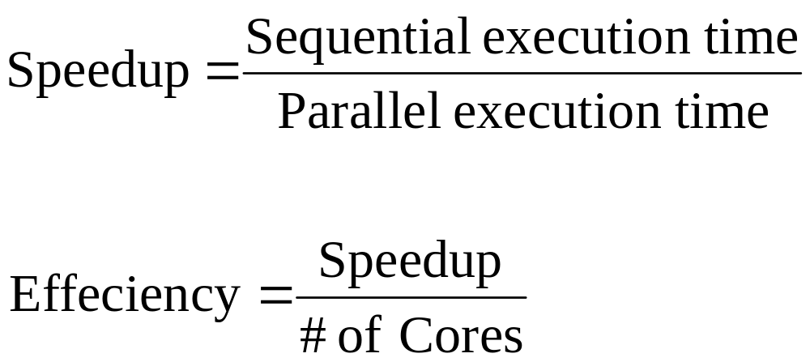
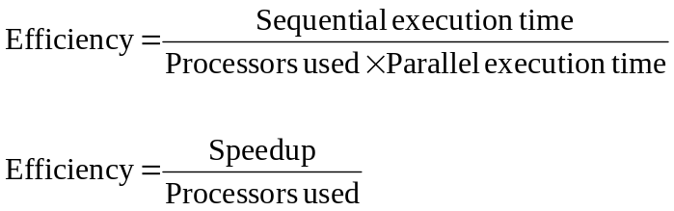
Efficiency

Slide 12
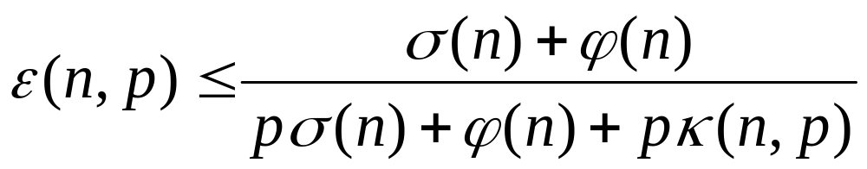
0 ≤ ε(n,p) ≤ 1
All terms > 0 ⇒ ε(n,p) > 0
Denominator > numerator ⇒ ε(n,p) < 1

Slide 13
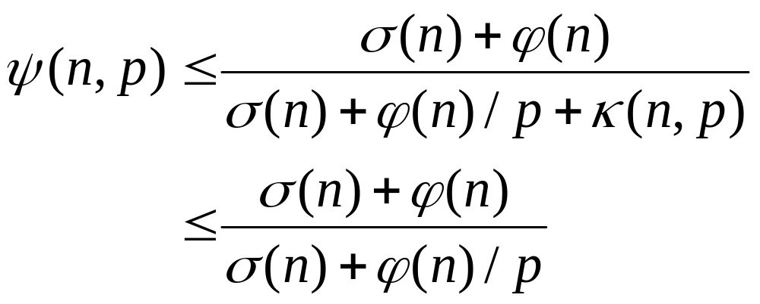
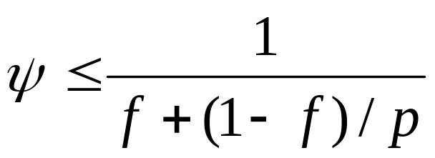
Amdahl’s Law
Let f = σ(n)/(σ(n) + ϕ(n)) Note: fix n changing p

Slide 14
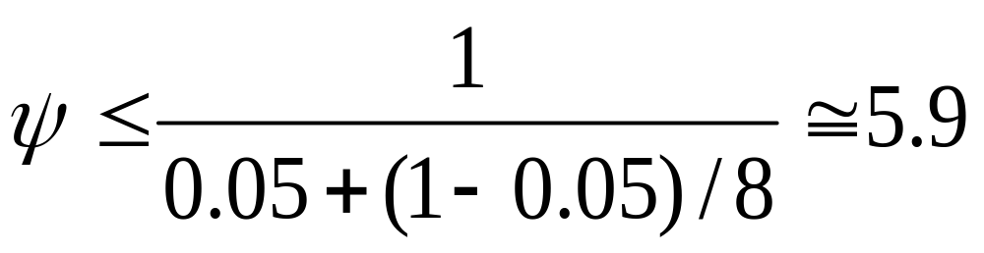
Example 1
95% of a program’s execution time occurs inside a loop that can be executed in parallel. What is the maximum speedup we should expect from a parallel version of the program executing on 8 CPUs?

Slide 15
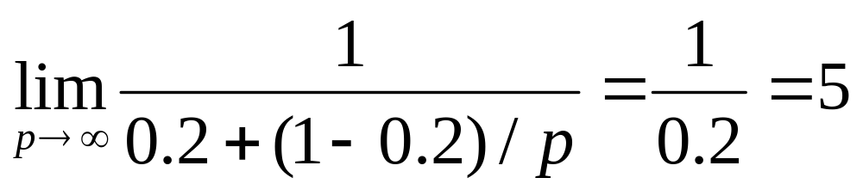
Example 2
20% of a program’s execution time is spent within inherently sequential code. What is the limit to the speedup achievable by a parallel version of the program?

Slide 16
Pop Quiz
An oceanographer gives you a serial program and asks you how much faster it might run on 8 processors. You can only find one function amenable to a parallel solution. Benchmarking on a single processor reveals 80% of the execution time is spent inside this function. What is the best speedup a parallel version is likely to achieve on 8 processors?

Slide 17
Pop Quiz
A computer animation program generates a feature movie frame-by-frame. Each frame can be generated independently and is output to its own file. If it takes 99 seconds to render a frame and 1 second to output it, how much speedup can be achieved by rendering the movie on 100 processors?

Slide 18
Limitations of Amdahl’s Law
Ignores κ(n,p)
Overestimates speedup achievable

Slide 19
Amdahl Effect
Typically κ(n,p) has lower complexity than ϕ(n)/p
As n increases, ϕ(n)/p dominates κ(n,p)
As n increases, speedup increases

Slide 20
Illustration of Amdahl Effect
Speedup
n = 10,000
n = 1,000
n = 100
Processors

Slide 21
Review of Amdahl’s Law
Treats problem size as a constant
Shows how execution time decreases as number of processors increases

Slide 22
Another Perspective
We often use faster computers to solve larger problem instances
Let’s treat the parallel execution time as a constant and allow problem size to increase with number of processors

Slide 23
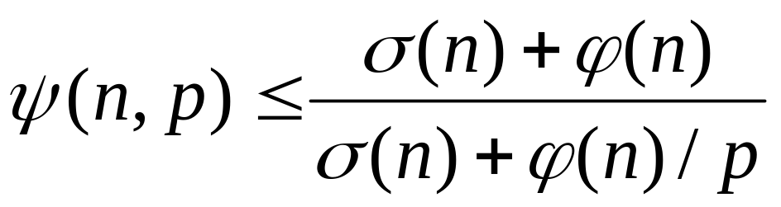
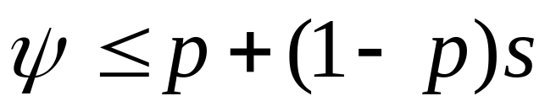
Gustafson-Barsis’s Law
Let s = σ(n)/(σ(n)+ϕ(n)/p) Note: σ(n)+ϕ(n)/p is fixed

Slide 24
Gustafson-Barsis’s Law
Begin with parallel execution time
Estimate sequential execution time to solve same problem
Problem size is an increasing function of p
Predicts scaled speedup

Slide 25
Example 1
An application running on 10 processors spends 3% of its time in serial code. What is the scaled speedup of the application?
…except 9 do not have to execute serial code
Execution on 1 CPU takes 10 times as long…

Slide 26
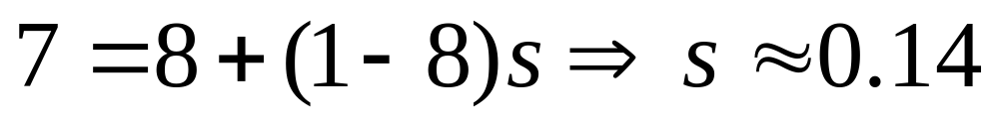
Example 2
What is the maximum fraction of a program’s parallel execution time that can be spent in serial code if it is to achieve a scaled speedup of 7 on 8 processors?

Slide 27
Pop Quiz
A parallel program executing on 32 processors spends 5% of its time in sequential code. What is the scaled speedup of this program?

Slide 28
The Karp-Flatt Metric
Amdahl’s Law and Gustafson-Barsis’ Law ignore κ(n,p)
They can overestimate speedup or scaled speedup
Karp and Flatt proposed another metric

Slide 29
Experimentally Determined Serial Fraction
Takes into account parallel overhead
Detects other sources of overhead or inefficiency ignored in speedup model
  Process startup time
  Process synchronization time
  Imbalanced workload
  Architectural overhead

Slide 30
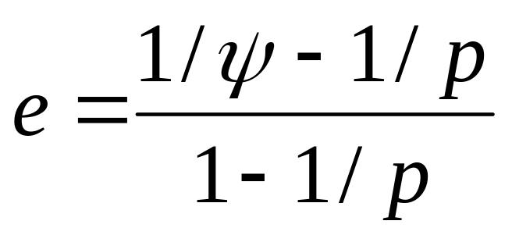
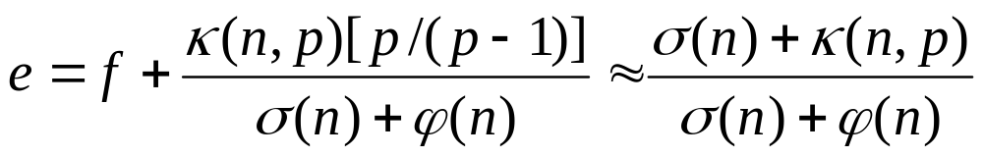
Experimentally Determined Serial Fraction
GOAL: Figure out the serial fraction
and communication overhead
by just running the program
without looking at the source code
or the underlying parallel algorithm

Slide 31
Example 1
p
2
3
4
5
6
7
8
ψ
1.8
2.5
3.1
3.6
4.0
4.4
4.7
What is the primary reason for speedup of only 4.7 on 8 CPUs?
e
0.1
0.1
0.1
0.1
0.1
0.1
0.1
Since e is constant, large serial fraction is the primary reason.

Slide 32
Example 2
p
2
3
4
5
6
7
8
ψ
1.9
2.6
3.2
3.7
4.1
4.5
4.7
What is the primary reason for speedup of only 4.7 on 8 CPUs?
e
0.070
0.075
0.080
0.085
0.090
0.095
0.100
Since e is steadily increasing, parallel overhead is the primary
reason.

Slide 33
Pop Quiz
p
4
8
12
ψ
3.9
6.5
?
Is this program likely to achieve a speedup of 10 on 12 processors?

Slide 34
Isoefficiency Metric
Parallel system: parallel program executing on a parallel computer
Scalability of a parallel system: measure of its ability to increase performance as number of processors increases
A scalable system maintains efficiency as processors are added
Isoefficiency: a way to measure scalability

Slide 35
Isoefficiency Derivation Steps
Begin with speedup formula
Compute total amount of overhead
Assume efficiency remains constant
Determine relation between sequential execution time and overhead

Slide 36
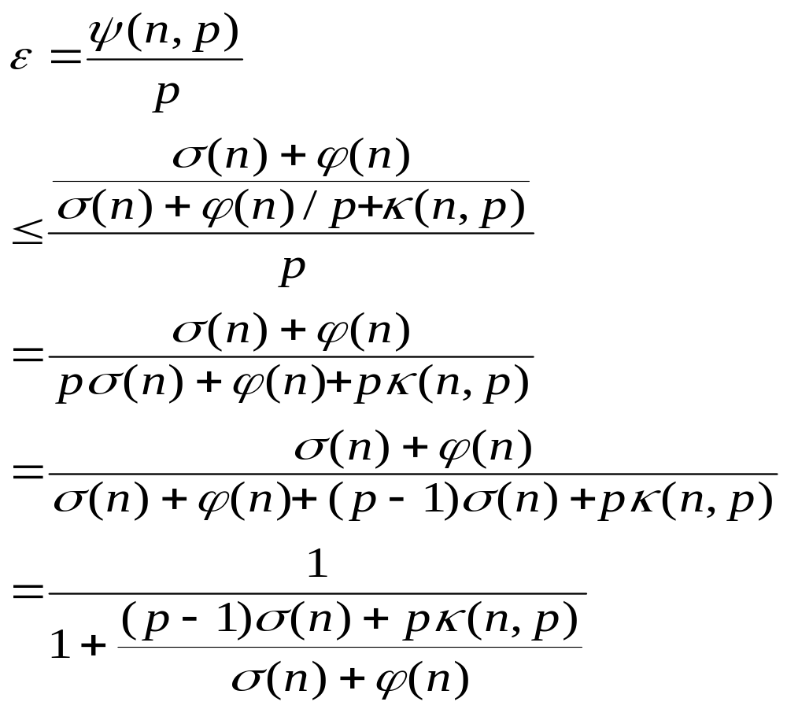
Deriving Isoefficiency Relation

Slide 37
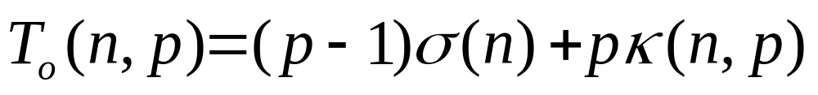
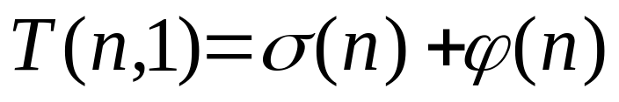
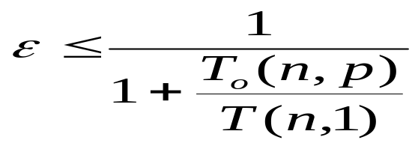
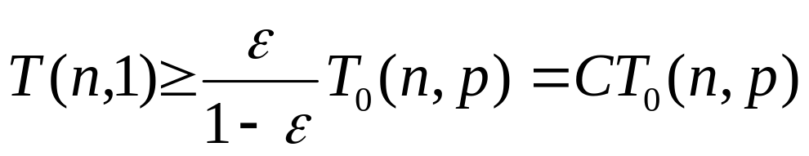
Deriving Isoefficiency Relation
Let
then, the formula in the previous slide becomes
Assume efficiency is constant, it can be re-write as
Isoefficiency Relation

Slide 38
Scalability Function
The isoefficiency relation can often be simplified as n ≥ f(p)
Let M(n) denote memory required for problem of size n
M(f(p))/p shows how memory usage per processor must increase to maintain same efficiency
We call M(f(p))/p the scalability function

Slide 39
Meaning of Scalability Function
To maintain efficiency when increasing p, we must increase n
Maximum problem size is limited by available memory, which is linear in p
Scalability function shows how memory usage per processor must grow to maintain efficiency
Scalability function is a constant means parallel system is perfectly scalable

Slide 40
Interpreting Scalability Function
Cplogp
Cannot maintain
efficiency
Cp
Memory Size
Memory needed per processor
Can maintain
efficiency
Clogp
C
Number of processors

Slide 41
Example 1: Reduction in Chapter 3
Sequential algorithm complexity
T(n,1) = Θ(n)
Parallel algorithm
  Computational complexity = Θ(n/p)
  Communication complexity = Θ(log p)
Parallel overhead
T₀(n,p) = Θ(p log p)

Slide 42
Reduction (continued)
Isoefficiency relation: n ≥ C p log p
We ask: To maintain same level of efficiency, how must n increase when p increases?
M(n) = n
The system has good scalability

Slide 43
Example 2: Floyd’s Algorithm in Chpater 6
Sequential time complexity: T(n,1)=Θ(n³)
Parallel computation time: Θ(n³/p)
Parallel communication time: Θ(n²log p)
Parallel overhead: T₀(n,p) = Θ(pn²log p)

Slide 44
Floyd’s Algorithm (continued)
Isoefficiency relation
n³ ≥ C(p n² log p) ⇒ n ≥ C p log p
M(n) = n²
The parallel system has poor scalability

Slide 45
Pop Quiz: Finite Difference (Ch 13)
Sequential time complexity per iteration: T(N,1)=Θ(n²)
Parallel communication complexity per iteration: Θ(n/√p)
Parallel overhead: T_o(n,p)=Θ(n √p)
Space Complexity: M(n) = n²
What is the scalability function?

Slide 46
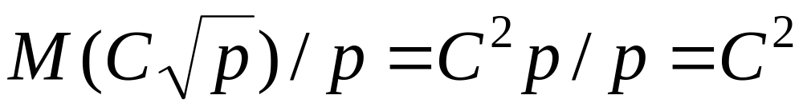
Finite Difference (continued)
Isoefficiency relation
n² ≥ Cn√p ⇒ n ≥ C√ p
M(n) = n²
This algorithm is perfectly scalable

Slide 47
Summary (1/3)
Performance terms
  Speedup
  Efficiency
Model of speedup
  Serial component
  Parallel component
  Communication component

Slide 48
Summary (2/3)
What prevents linear speedup?
  Serial operations
  Communication operations
  Process start-up
  Imbalanced workloads
  Architectural limitations (memory)

Slide 49
Summary (3/3)
Analyzing parallel performance
  Amdahl’s Law
  Gustafson-Barsis’ Law
  Karp-Flatt metric
  Isoefficiency metric

